Slide 1


Music Genre Classification
Kaggle Competition organized by shai for ai

Slide 2






Table of Content
Look at the Big Picture
Explore and Visualize Data to Gain Insights
Feature Engineering
Model Training
Final Model

Slide 3

Look at The Big Picture

Slide 4

Dataset Overview:
artist: Name of the Artist.
song: Name of the Track.
popularity: The higher the value the more popular the song is.
danceability: Danceability describes how suitable a track is for dancing based on a combination of musical elements including tempo, rhythm.
energy: Energy is a measure from 0.0 to 1.0 and represents a perceptual measure of intensity and activity.
key: The key the track is in. Integers map to pitches using standard Pitch Class notation. E.g. 0 = C, 1 = C♯/D♭, 2 = D, and so on..
loudness: The overall loudness of a track in decibels (dB). Loudness values are averaged across the entire track and are useful for comparing relative
mode: Mode indicates the modality (major or minor) of a track, the type of scale from which its melodic content is derived. Major is represented by 1 and minor is 0.
speechiness: Speechiness detects the presence of spoken words in a track. The more exclusively speech-like the recording (e.g. talk show, audio book, poetry), the closer to 1.0 the attribute value. Values above 0.66 describe tracks that are probably made entirely of spoken words. Values between 0.33 and 0.66 describe tracks that may contain both music and speech, either in sections or layered, including such cases as rap music. Values below 0.33 most likely represent music and other non-speech-like tracks.

Slide 5
Dataset Overview:
acousticness: A confidence measure from 0.0 to 1.0 of whether the track is acoustic. 1.0 represents high confidence the track is acoustic.
instrumentalness: Predicts whether a track contains no vocals. "Ooh" and "aah" sounds are treated as instrumental in this context. Rap or spoken word tracks are clearly "vocal". The closer the instrumentalness value is to 1.0, the greater likelihood the track contains no vocal content. Values above 0.5 are intended to represent instrumental tracks, but confidence is higher as the value approaches 1.0.
liveness: Detects the presence of an audience in the recording. Higher liveness values represent an increased probability that the track was performed live. A value above 0.8 provides strong likelihood that the track is live.
valence: A measure from 0.0 to 1.0 describing the musical positiveness conveyed by a track. Tracks with high valence sound more positive (e.g. happy, cheerful, euphoric), while tracks with low valence sound more negative (e.g. sad, depressed, angry).
tempo: The overall estimated tempo of a track in beats per minute (BPM). In musical terminology, tempo is the speed or pace of a given piece and derives directly from the average beat duration.
duration in milliseconds :Time of the song.
time_signature : a notational convention used in Western musical notation to specify how many beats (pulses) are contained in each measure (bar), and which note value is equivalent to a beat.
Class: Genre of the track.

Slide 6


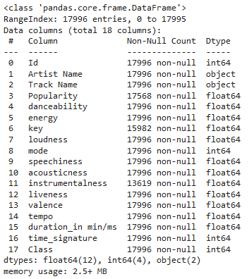
Dataset Information:
The dataset consists of 17.995 entries and 18 columns.
The columns are mostly of type float64, with some being int64 and object.

Slide 7
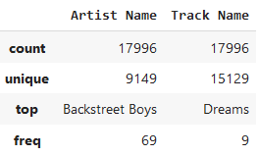
Dataset Information:
more information about String features
Artist Diversity: There is a significant diversity in the artists represented, with 9149 unique artists.
Popularity: Backstreet Boys are the most frequent artist in this dataset, it appears 69 times indicating their high popularity.
Track Diversity: The dataset contains a wide variety of tracks, with 15129 unique track names.
Most Common Track: The track "Dreams" is the most common, but it only appears 9 times, suggesting a high variety of tracks overall.

Slide 8

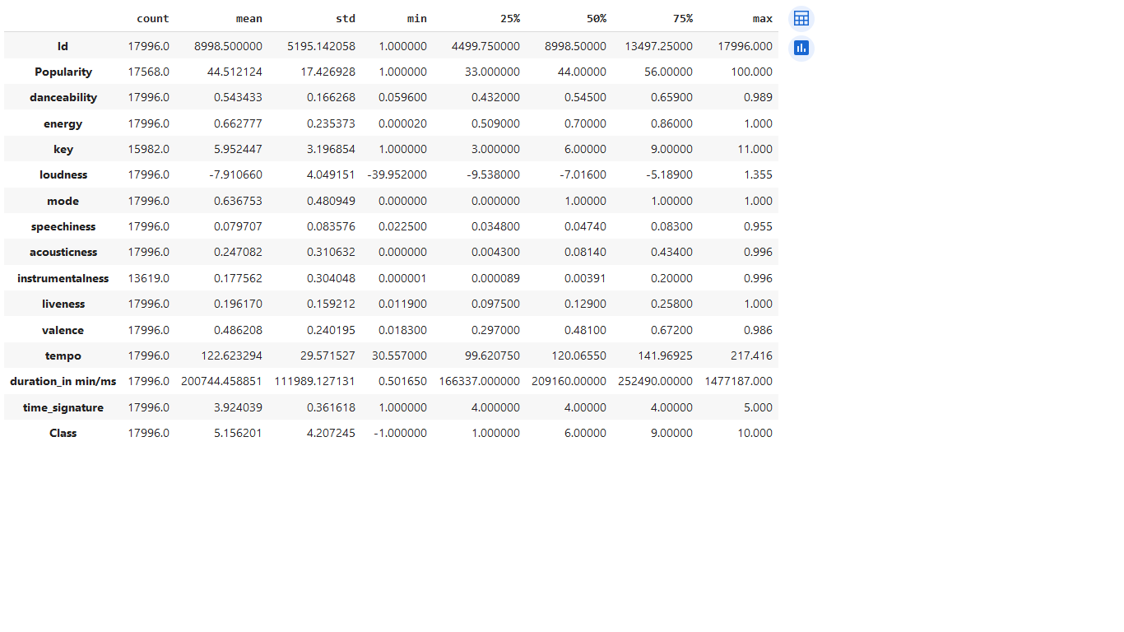
Dataset Description:

Slide 9

Explore and Visualize Data to Gain Insights

Slide 10

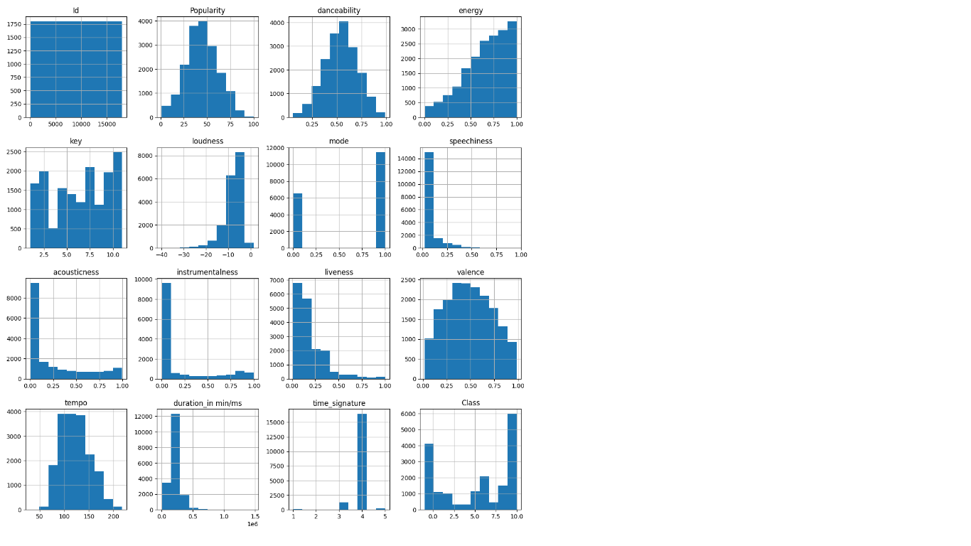
Histogram plot

Slide 11
Histogram plot
Popularity, Danceability : most tracks have moderate popularity and danceability.
Energy: many tracks are high-energy.

Slide 12
Histogram plot
3.Key: certain keys are slightly more common.
4.Loudness: most tracks around -10 dB, typical of modern music production.
5.Mode: more tracks in a major key (mode = 1)

Slide 13
Histogram plot
5.Speechiness, Acousticness, Instrumentalness, Liveness: are not very speech-like, acoustic, instrumental, or Live.
6.Valence: balanced emotional tone across tracks.

Slide 14
Histogram plot
7.Tempo: peaking around 120 BPM, common for many genres.
8.Duration in milliseconds: the majority of tracks lasting under 500,000 milliseconds (approximately 8.3 minutes).
9.Time Signature: Heavily dominated by 4/4 time, which is standard in most Western music.

Slide 15
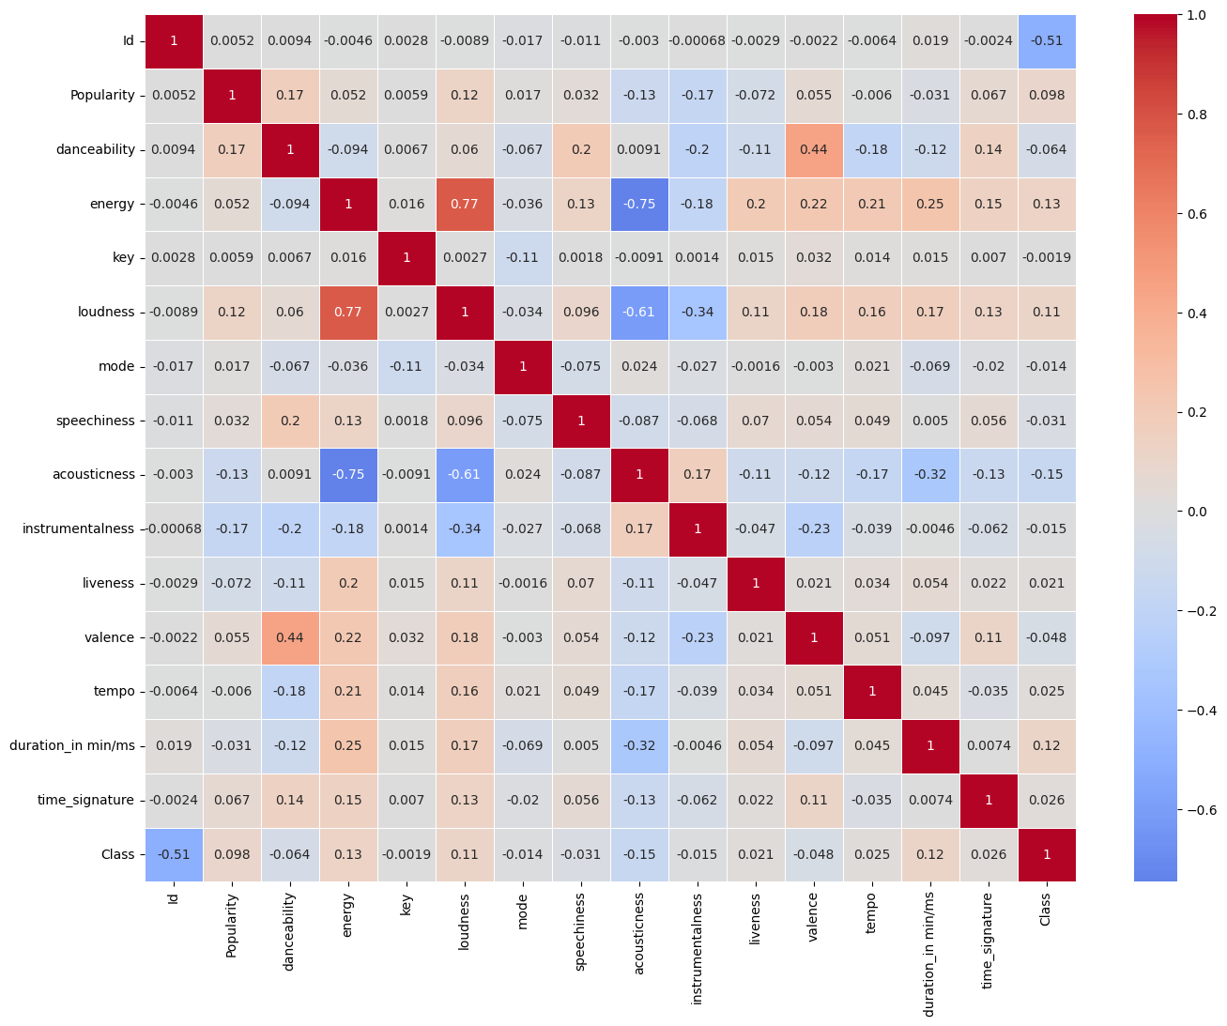
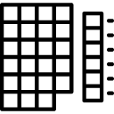
Correlation
Matrix

Slide 16
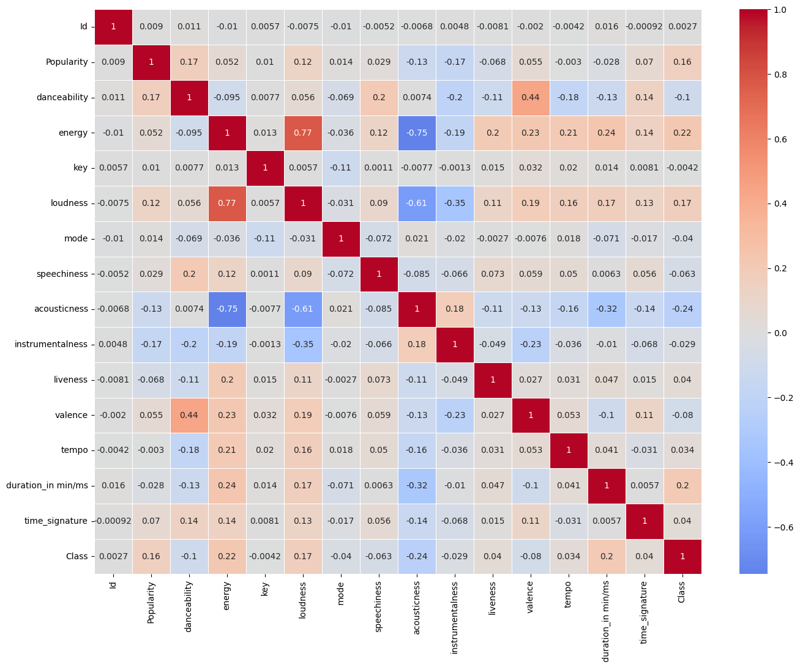
Correlation
Matrix
Loudness shows a strong positive correlation with energy (0.77) and a moderate positive correlation with popularity (0.12). This indicates that louder, more energetic tracks are generally more popular.

Slide 17
Correlation
Matrix
Valence has a moderate positive correlation with danceability (0.44) and energy (0.23), indicating that happier-sounding tracks tend to be more danceable and energetic.

Slide 18
Correlation
Matrix
Tempo shows a weak correlation with most variables but has a small positive correlation with energy (0.21), suggesting that faster tempos might contribute slightly to higher energy levels in tracks.

Slide 19
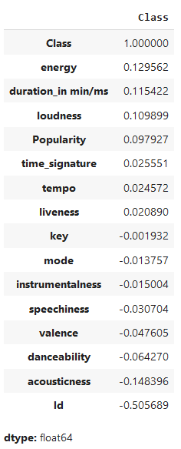
Correlation With ‘Class’
there is no strong linear relationship between the features and the label.

Slide 20

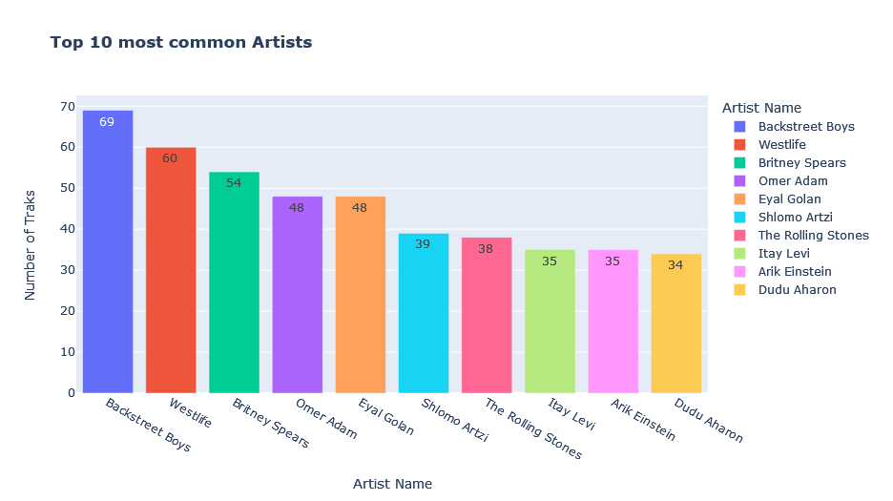
Top 10 Artists

Slide 21
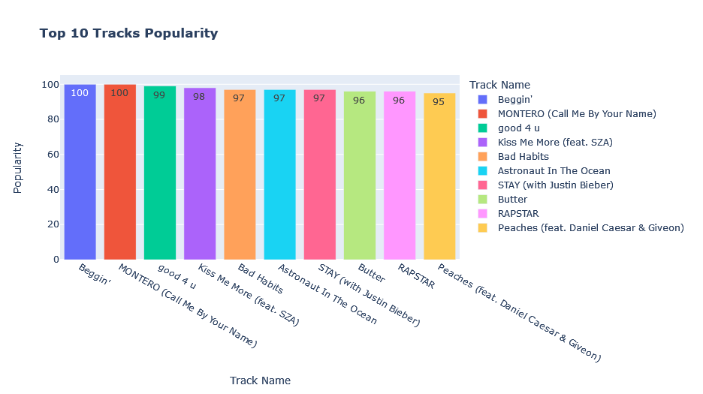
Top 10 Tracks Popularity

Slide 22

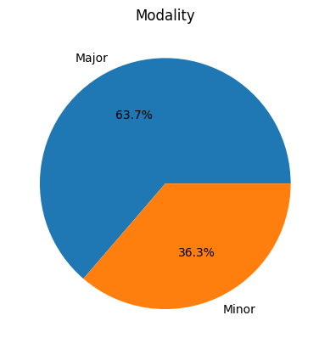
Modality
the majority of tracks in the dataset are in a major key (63.7%), while minor key tracks make up a smaller proportion (36.3%). This suggests a general preference for major keys in the dataset.

Slide 23

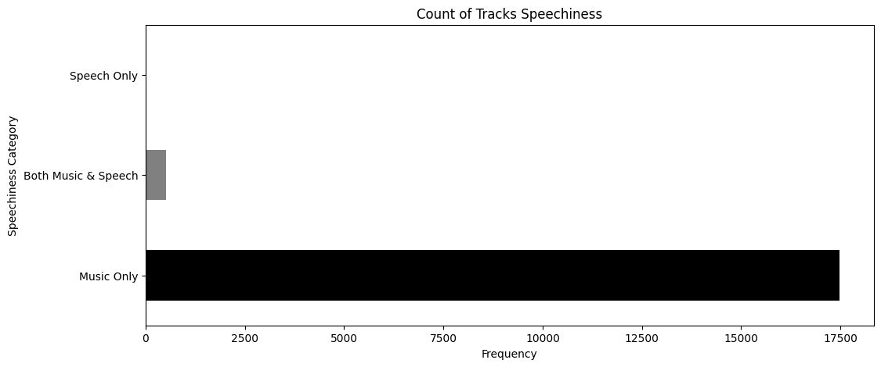
Count of Tracks Speechiness
The vast majority of tracks in the dataset are classified as "Music Only," indicating a low presence of spoken words. This suggests that the dataset primarily consists of instrumental or vocal music with minimal spoken content.

Slide 24
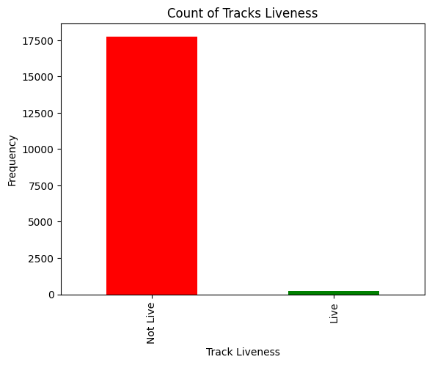
Count of Tracks Liveness
The vast majority of tracks in the dataset are classified as "Not Live".
This indicates a low likelihood of the tracks being recorded in a live setting.
This suggests that the dataset predominantly consists of studio recordings rather than live performances.

Slide 25
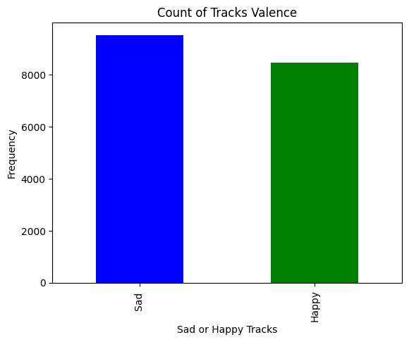
Count of Tracks Valence
The distribution of valence, which measures the musical positiveness of a track, is almost balanced between "Sad" and "Happy" categories.
This suggests that the dataset contains a diverse range of emotions, offering a mix of tracks that evoke both positive and negative feelings.

Slide 26

Feature Engineering

Slide 27


Feature Extraction
Converting the ‘duration_in min/ms’ column into min :
-The `dur` variable stores the values from the `duration_in
min/ms` column of the DataFrame.
-Two empty lists, `track` and `clean`, are initialized to hold processed data.
The loop iterates over each value in the `dur` list.
- If the value is less than or equal to 100:
-The value is appended to `clean` without any modification.
-The `track` list is appended with `0`, indicating that the value is in minutes.

Slide 28
Feature Extraction
If the value is greater than 100 :
-The value is assumed to be in milliseconds, so it's divided by 60,000 to convert it into minutes.
-The `track` list is appended with `1`, indicating that the value was in milliseconds and was converted to minutes.
-The original `duration_in min/ms` column in Data frame is updated with the values from `clean`, meaning all the values are now consistently in minutes.
- A new column `new1` is added to the DataFrame. This column indicates the original unit of the duration (`0` for minutes, `1` for milliseconds).

Slide 29
Feature Engineering
-Importance in a Classifier:
Consistency : Ensures all inputs are consistent, which is crucial for accurate predictions
1.`new2`: Length of the 'Artist Name' (number of characters).
2. `new3`: Length of the 'Track Name' (number of characters).
3. `new4`: Number of words in the 'Artist Name' (based on splitting the string by spaces).
4. `new5`: Number of words in the 'Track Name’.
5. `new6`: Number of uppercase letters in the 'Artist Name'.

Slide 30
Feature Engineering
6. `new7`: Number of lowercase letters in the 'Artist Name'.
7. `new8`: Number of digits in the 'Artist Name'.
8. `new9`: Number of uppercase letters in the 'Track Name'.
9. `new10`: Number of lowercase letters in the 'Track Name'.
10. `new11`: Number of digits in the 'Track Name'.
11. `new12`: Count of special characters in the 'Artist Name' (not uppercase, lowercase, or digits). Calculated by subtracting the sum of uppercase and lowercase counts from the total length of the 'Artist Name'.
12. `new13`: Count of special characters in the 'Track Name' (not uppercase, lowercase, or digits). Similar logic as `new12`, applied to 'Track Name'.

Slide 31
Feature Engineering
Why These Features Might Be Useful ?
Text Characteristics as Predictors:
In a music genre classification task, the characteristics of the `Artist Name` and `Track Name` might provide hints about the genre. For example:
Length of Name: Certain genres might have trends in artist or track name lengths.
Uppercase/Lowercase Letters: Some genres might favor stylized names with more uppercase letters or special characters.
Digits in Names: Genres like EDM or hip-hop might use numbers more frequently in track or artist names.

Slide 32
Feature Engineering
Why These Features Might Be Useful ?
-Model Input: - These features can be fed into a machine learning model to help it learn patterns associated with different music genres, improving its predictive power.
Example Use Case*
-Pop Music: Shorter, simpler track names, potentially fewer special characters.
- Hip-Hop: More use of digits, special characters, and stylized names with uppercase letters.
- Classical: Longer artist names, possibly fewer special characters.

Slide 33
Feature Engineering
-Standardize the text by converting it to lowercase:
Why??
1. Case Insensitivity:
- Converting text to lowercase is a common preprocessing step in text data to make the data case-insensitive. This ensures that variations in capitalization (e.g., "The Beatles" vs. "the beatles") are not treated as different entities.
2. Consistency in Feature Engineering:
- By converting all text to lowercase, subsequent feature engineering processes, such as counting specific characters, words, or patterns, will yield consistent results.
3. Improved Model Performance:
- Machine learning models often perform better when the input data is consistent and standardized. By cleaning the text, the model can focus on the meaningful patterns in the data rather than getting distracted by irrelevant variations like case differences.

Slide 34

Model Training
AutoGluon

Slide 35
Model Training:
We Have Used AutoGluon to select our machine learning model.
AutoGluon Configurations:
Best Quality: Automatically selects the best-performing model.
Auto Stack: Enhances model performance through automated stacking.

Slide 36
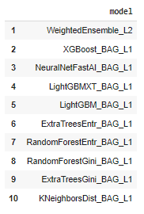
Final Model:
The Best Model:
Weighted Ensemble of the best models
with l2 regularization to avoid overfitting
Final F1 Score:
.74718

Slide 37


Thank You

